Slide 1
INSTALLING WORDPRESS USING Docker

Slide 2
AGENDA
Introduction
Prerequisites
Project Setup
Docker Compose Configuration
Starting the Containers
Accessing and Setting Up WordPress
Managing Containers
Q&A and Conclusion

Slide 3
Introduction
Brief overview of WordPress
Importance of using Docker for development
Goals of the session:
Set up a local WordPress environment using Docker
Understand the configuration and management of Docker containers

Slide 4
Prerequisites
S1
Docker: Install from Docker's official website
S2
Docker Compose: Typically included with Docker Desktop
S3
Text Editor: Any text editor like VS Code, Sublime Text, etc.
S4
Basic Knowledge: Understanding of Docker and Docker Compose

Slide 5

Project Setup
Create a directory for your WordPress project:
mkdir wordpress-docker
cd wordpress-docker

Slide 6
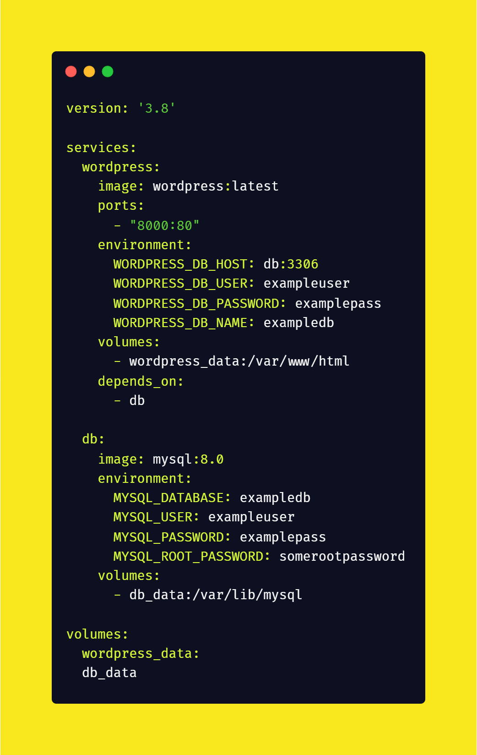
Docker Compose Configuration
Create a docker-compose.yml file with the following content.
Explanation of the file structure and components

Slide 7
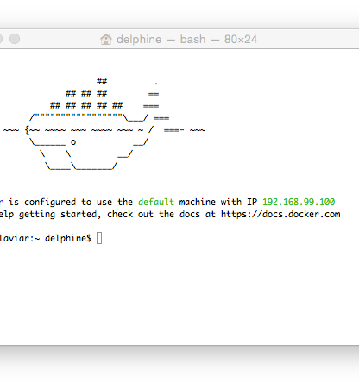
Starting the Containers
Run the following command to start the containers:
docker-compose up –d
Explanation of the -d flag (detached mode)
This Photo by Unknown Author is licensed under CC BY-SA-NC

Slide 8
Accessing and Setting Up WordPress
Navigate to http://localhost:8000 in your web browser
Follow the on-screen instructions to complete the WordPress setup
Database Name: exampledb
Username: exampleuser
Password: examplepass
Database Host: db:3306
Table Prefix: *Leave as default or change if needed

Slide 9
Managing Containers
Stopping the containers:
docker-compose down
Viewing logs:
docker-compose logs -f
Updating configuration:
Modify `docker-compose.yml` and restart:
docker-compose up -d

Slide 10
Q&A and Conclusion
Open floor for questions
Recap of what was covered:
Setting up a local WordPress environment using Docker
Configuration and management of Docker containers

Slide 11
Thank you
Danish Saleem
danish_s@outlook.com | LinkedIn: MrDanishSaleem

